Slide 1
Servlets Continued

Slide 2
Servlet Container
A servlet container manages the life cycle of a servlet.
Servlet is an interface defined in javax.servlet package.
A servlet container uses the Servlet interface to understand a specific Servlet object and manage it.

Slide 3
Servlet Interface
init()
method is used to initialize the servlet
method is called only once
service()
Called each time a request for the servlet is received
calls doGet(), doPost(), doPut(), doDelete(), etc. methods as appropriate
destroy()
method is called only once at the end of the a servlet's life

Slide 4
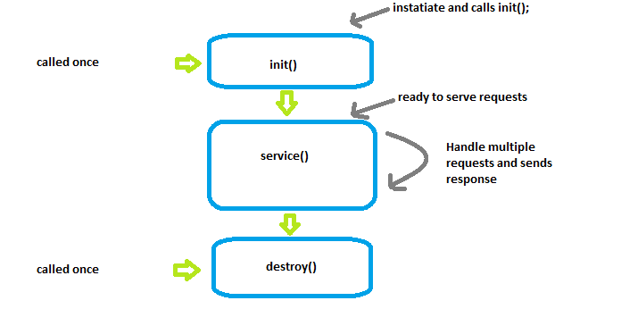
Lifecycle of a Servlet

Slide 5
ServletRequest and ServletResponse
Allow us to get information contained in the request and set information to include in the response
ServletRequest:
getParameter(“name_of_parameter”)
Returns a String
getParameterNames()
Returns an Enumeration of String values- Enumeration<String>
getParameterMap()
Returns Map<String, String[]>
getHeader("NAME_OF_HEADER")
Returns the value of the specified header
ServletResponse:
setHeader("NAME_OF_HEADER", "VALUE_OF_HEADER");
get…
getWriter
getOutputStream
sendRedirect(“path”);

Slide 6
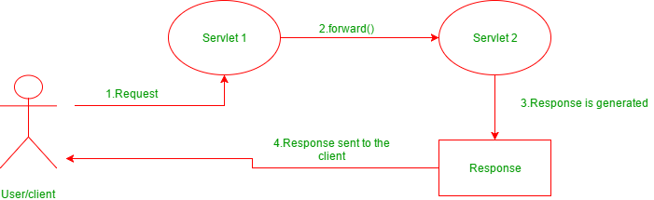
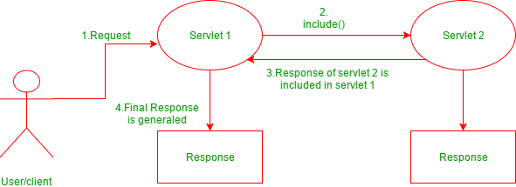
Request Dispatcher interface
forward(ServletRequest request, ServletResponse response)
passes a request from one servlet to another resource on the server
request and response are forwarded to the next resource which processes the data and returns the response to the client
include(ServletRequest request, ServletResponse response)
does not entirely transfer full control to the next resource
includes the content of the original resource in the response returned to the client

Slide 7
Examples
// "request" is a HttpServletRequest Object and "hello.html" is a resoure name
RequestDispatcher rd = request.getRequestDispatcher("hello.html");
//includes the response of "hello.html" page in current servlet response
rd.include(request,response);
Example of using includes
// "request" is a HttpServletRequest Object and "hello.html" is a resoure name
RequestDispatcher rd = request.getRequestDispatcher("hello.html");
//forward the request and response to “hello.html" page
rd.forward(request,response);
Example of using forward

